Slide 1

Allergic & Non-Allergic Rhinitis
Dr.Haval Ahmed Hama
MBChB, F.K.B.M.S
(Otolaryngology, Head and Neck Surgeon)
University of Sulaimani, College of Medicine.
Branch of clinical science.

Slide 2
learning Objectives
Understanding to define allergy.
Able to categorize types of rhinitis.
Learning how to approach a patient with an allergy
Enhancing knowledge regarding how to manage patients with rhinitis.

Slide 3
Definition
Rhinitis is a group of disorders characterized by inflammation and irritation of the mucous membranes of the nose.
As the lining of the nasal cavity and paranasal sinus is the same so it involves both of them

Slide 4

Classification
Rhinitis
Infected
Non-Infected
Allergic
Vasomotor
Acute
Chronic
Viral
Seasonal
Perineal
Bacterial
Specific
Non Specific
Atrophic
Simple chronic
Hypertrophic
Rhinitis sicca
Rhinitis caseosa
Granulomatous rhinitis

Slide 5
Specific
leishmaniosis
Fungal infection
Syphilis
Tuberculosis
leprosy
Rhinosporiodosis
Rhinoscleroma

Slide 6
Allergic Rhinitis
IgE-mediated hypersensitivity reaction in genetically susceptible individuals of nasal mucosa that is characterized by sneezing, itching, watery nasal rhinorrhea, and nasal obstruction.
Prevalence:
-15%-20% of population
-more common in pediatrics
-about 80% occur before the age of 20

Slide 7
Risk factor
1-Genetic susceptibility
2-Family history of atopy: eg. asthma, eczema, urticarial
3-Environmental factors:
-pollution-climate interaction
-irritants: eg. fumes, tobacco
4-Exposure to allergens:
.seasonal: pollen, fungus
.perennial: dust mites, domestic pets, cockroaches
5-Hygenic hypothesis: childhood exposure to allergens and infestation with worms will protect from allergy by the maturation of immunity

Slide 8
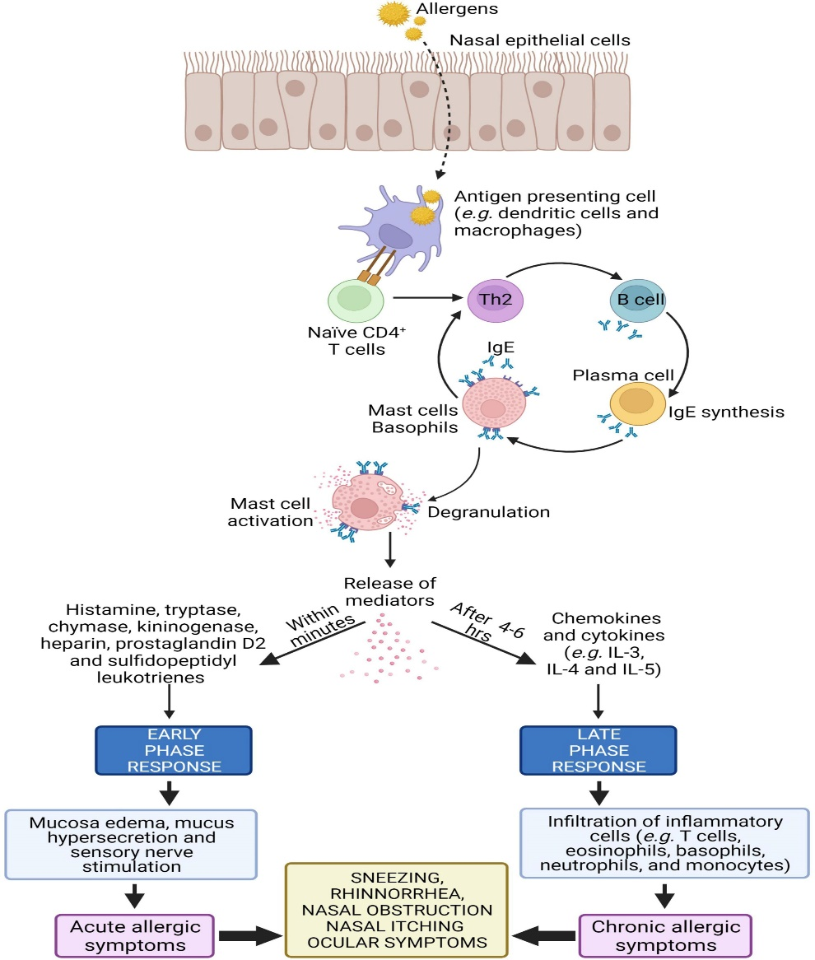
Pathogenesis
Sensitization & Priming to specific antigen:
Inhaled allergen produces specific IgE antibody which gets attached to mast cells
Subsequent exposure to same antigen: Allergen combines with specific IgE antibody → degranulation of mast cells → chemical mediators released.

Slide 9
Phase Response
Acute or early phase response:-
Occurs 5–30 min after antigen exposure
Release of inflammatory mediators(HISTAMEN &LEUKOTRINE)
Increased nasal gland secretion → runny nose
Mucosal edema & Vasodilation → nose block
Nerve irritation → sneezing & itching
Late or delayed phase response
• Occurs 2-8 hours after antigen exposure
• Infiltration by inflammatory cells (eosinophils, neutrophils, basophils, monocytes & CD4+ T lymphocytes)
• Edema, congestion & thick nasal secretion
• Sneezing & itching decreases

Slide 10
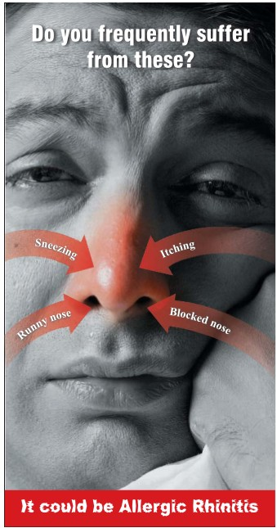
Clinical Features
Symptoms:
-Running
-Blocking
-Sneezing
-Itching

Slide 11
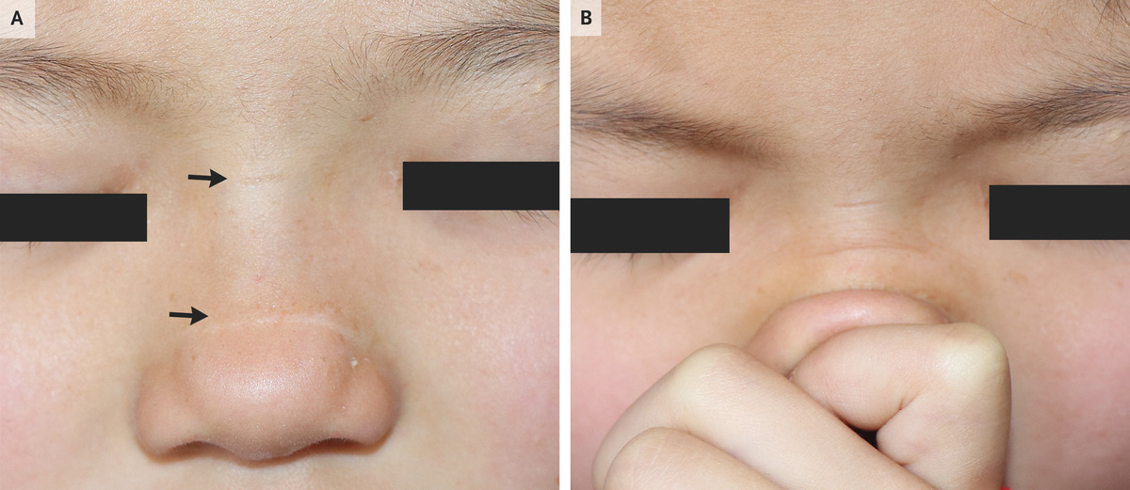
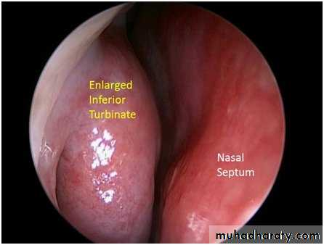
Signs:
Nose:
Allergic salute(transverse nasal crease)
Pale–blue enlarged turbinates

Slide 12
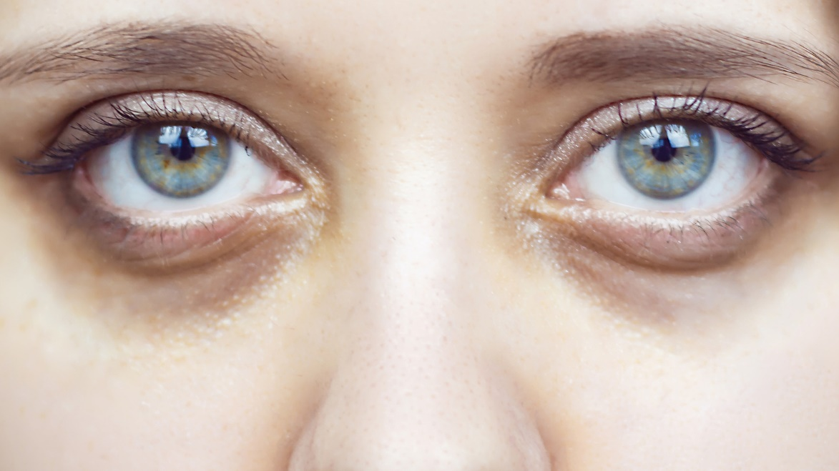
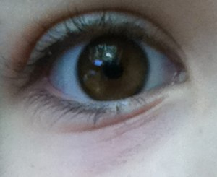
Face:
Dennie-Morgan creases (in lower eyelid skin)
-
Allergic shiners (dark discoloration below lower eyelids)

Slide 13
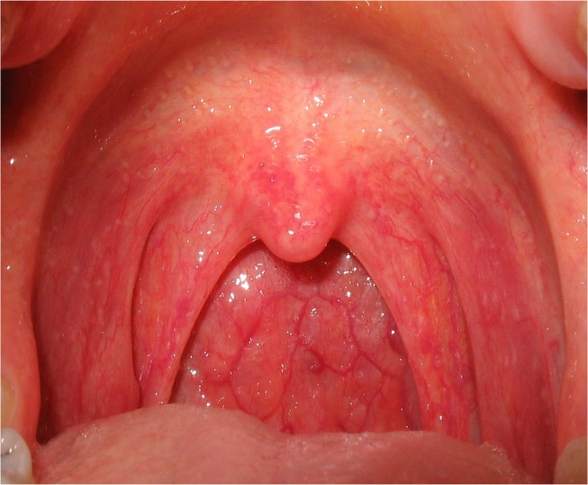
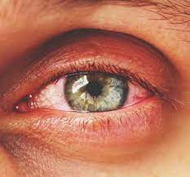
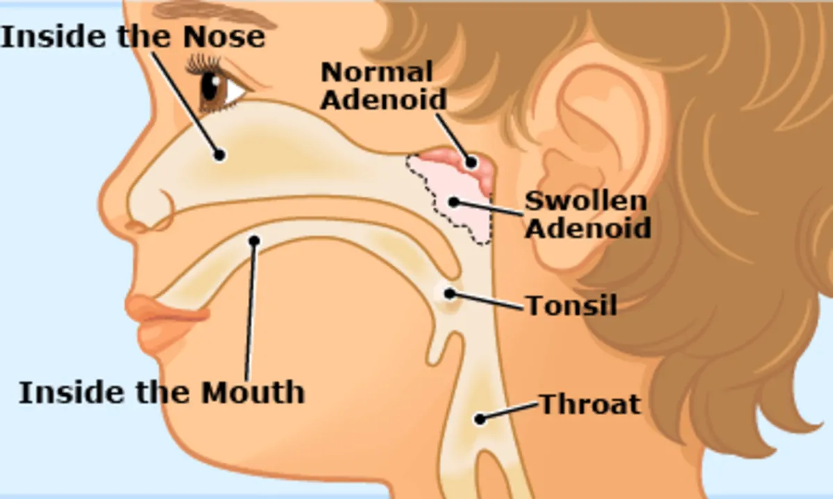
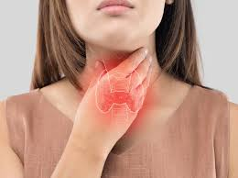
Eye: Conjunctiva is congested, increased lacrimation
Ear: Aural fullness(Eustachian tube dysfunction) due to adenoid hypertrophy
Throat: Chronic pharyngitis, laryngitis

Slide 14
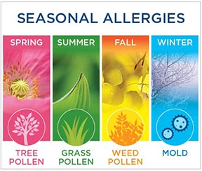
Types of allergic rhinitis
Seasonal allergic rhinitis:
Nasal discharge and conjunctivitis (more common)
Pollen:
-Spring (March-June)----tree pollen
Summer (May-August)----Grass
Fall (August-October)----Weeds
Mold: Spores outdoors have seasonal variation (reduced in winter, increased in summer/fall due to humidity)
House dust mites: Generally “perennial” allergen, but increased in damp autumn months

Slide 15
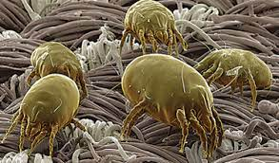
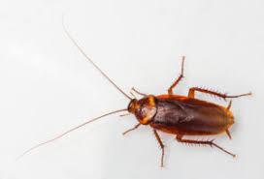

Perennial allergic rhinitis:
Nasal blockage (more common), Hyposmia Less sneezing/nasal discharge /eye symptoms
Fungi/mold:
Exposure peaks accompany activities such as harvesting & cutting grass
Pet dander:
(cats, dogs): up to 4 months after pet removal
House dust mites:
Live in bedding & carpets
Cockroaches:
Respiratory allergy
Important allergen

Slide 16
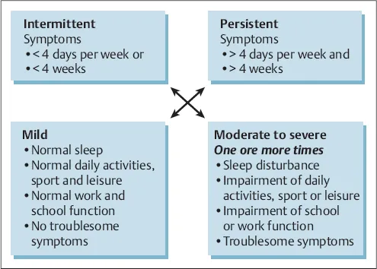
ARIA classification= Allergic Rhinitis & its Impact on Asthma

Slide 17
Diagnosis
1. History
2. Physical exam
3. Allergy diagnosis
(I) Skin prick test (SPT)
(II) Blood tests for allergy: Total IgE, Specific IgE
(III) Nasal allergen challenge test

Slide 18
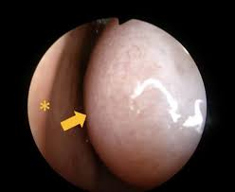
History and physical exam
History: Complete personal and family history especially for allergies.
Examination :
-General: looking for signs of allergy like eczema
-local ENT examination: allergic nose appear as pale blue mucosa with enlarged turbinates, watery nasal discharge, and some time with deviated nasal septum(DNS), nasal polyp
-Systematic ENT examination :ear ,throat, eye

Slide 19
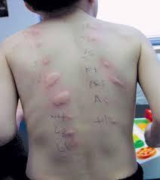

I. Skin prick test (SPT)
Rapid, efficient & cost-effective
Contain multiple antigens (pollen, mold, dust mite, animal dander)
Advantages:
1. Cheap
2. Immediate result
3. Sensitive
Contraindications:
1. Patients on antihistamines
2. Severe eczema
3. Previous anaphylaxis
4. Dermatographism

Slide 20
(II) Blood tests for allergy
1. Total IgE: Rarely helpful as 50% patients have IgE levels within normal range
2. Specific IgE:
(i) Radio-allergosorbent test (RAST)
(ii)Modified RAST Stabilized allergen is incubated with the patient’s serum

Slide 21
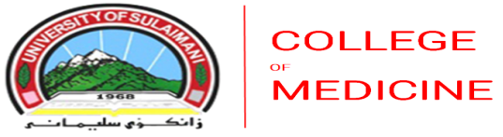
Immunoassay vs Skin Test for Diagnosis of Allergy
Immunoassay
-Not influenced by medication
-Not influenced by skin disease
-Does not require expertise
-Quality control possible
-Expensive
Skin test
-Higher sensitivity
-Immediate results
-Requires expertise
-Cheaper

Slide 22
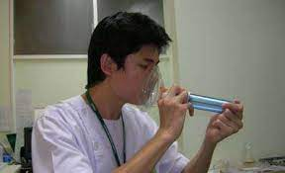
(III)Nasal allergen challenge (nasal provocation) test
Indication: positive history & negative SPT
Disadvantages
1. Time-consuming
2. Difficult
3. Excessive lab facilities
4. Trained staff 5.Resuscitation equipment

Slide 23
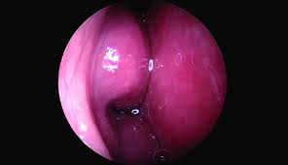
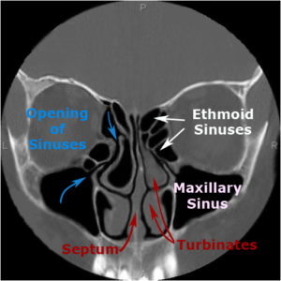
Nasal endoscopy CT scan-Nose and PNS

Slide 24
Management of allergic rhinitis
1. Environmental control measures (Avoidance of allergens)
2. Nasal douching
3. Medical therapy
4. Immunotherapy
5. Surgery

Slide 25
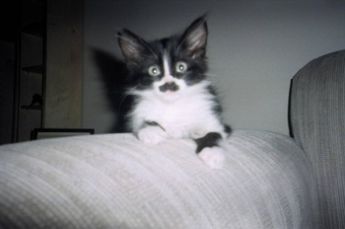
Globally important sources of allergens
House dust mites
Grass, tree and weed pollen
Pets
Cockroaches
Molds

Slide 26
Pets
-Remove pets from bedrooms and, even better, from the entire home
-Vacuum carpets, mattresses and upholstery regularly
-Wash pets regularly (±)
Molds
-Ensure dry indoor conditions
-Use ammonia to remove mold from bathrooms and other wet spaces

Slide 27
Cockroaches
-Eradicate cockroaches with appropriate gel-type, non-volatile, insecticides
-Eliminate dampness, cracks in floors, ceilings, cover food; wash surfaces, fabrics to remove allergen
Pollen
-Remain indoors with windows closed at peak pollen times
-Wear sunglasses
-Use air-conditioning, where possible
-Install car pollen filter

Slide 28
(I) Avoidance of allergens
Best treatment method
Indoor allergens: Removing allergens from the indoor environment should be a primary strategy for the management and treatment of allergic disease
Outdoor allergens: Avoid irritants: smoke, and dust.
Avoidance of animal allergen: remove pet animals (cats, dogs) from the bedroom.
Measures to avoid house dust mite: Covers for pillows & bedding.
Pollen avoidance measures: Avoid walking in open grassy spaces during hot, dry days, keep windows closed, and wear facemask & sunglasses when moving out.

Slide 29
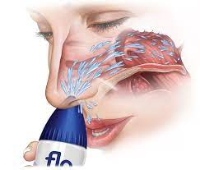
(II) Nasal douching
Saline irrigation
Improves quality of life

Slide 30
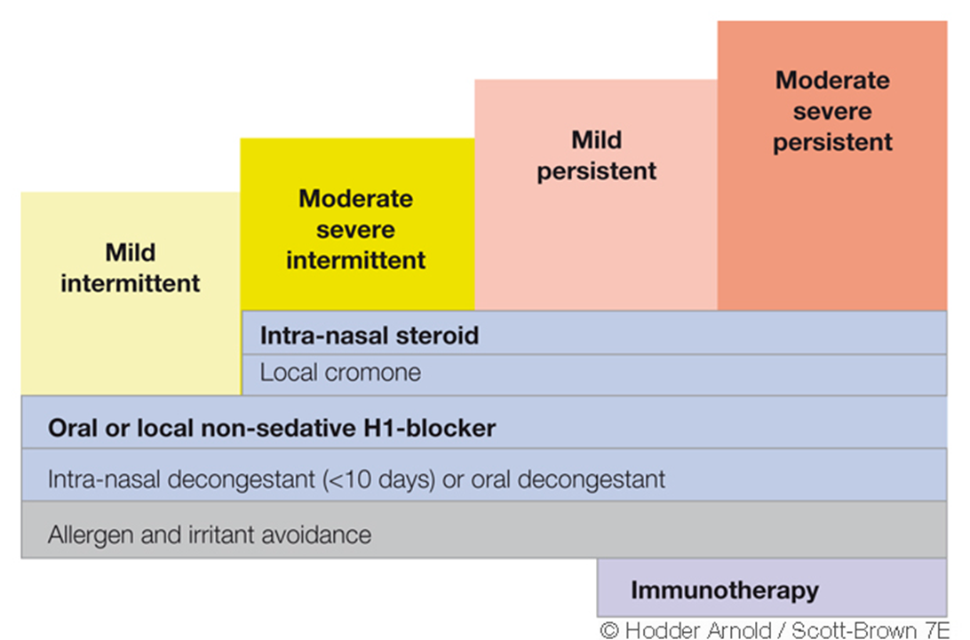
(III) Medical therapy

Slide 31
Newer Generation Oral Antihistamines
-First-line treatment for mild allergic rhinitis
Effective for:-
-Rhinorrhea
-Nasal pruritus
-Sneezing
Less effective for nasal blockage
Minimal or no sedative effects
Once daily administration
Rapid onset and 24-hour duration of action

Slide 32
Decongestants: Alpha-2 Adrenergic Agonists
Oral
Pseudoephedrine
Nasal
Phenylephrine
Oxymetazoline
Xylometazoline

Slide 33
EFFICACY:
Oral decongestants: moderate
Nasal decongestants: high
ADVERSE EFFECTS:
Oral decongestants: insomnia, tachycardia, hyperkinesia,tremor, increased blood pressure, stroke (?)
Nasal decongestants: tachyphylaxis, rebound congestion, nasal hyperresponsiveness, rhinitis medicamentosa

Slide 34
Anti-leukotriene agents
CysLT1 Receptor
Antagonists
-Montelukast
-Pranlukast
-Zafirlukast
5-Lipoxygenase
Inhibitors
-Zileuton

Slide 35
Efficacy:
Equipotent to H1 receptor antagonists but with onset of action after 2 days
Reduce nasal and systemic eosinophilia
May be used for simultaneous treatment of allergic rhinitis and asthma
Safety:
Dyspepsia (approx. 2%)

Slide 36
Nasal Corticosteroids
Topical
-Beclomethasone dipropionate
-Budesonide
-Fluticasone propionate
-Mometasone furoate
Systemic
-Prednisolon
-Dexamtehazone
-Depomedrol

Slide 37
Intranasal corticosteroid
Most potent anti-inflammatory agents
Effective in treatment of all nasal symptoms including obstruction
Superior to anti-histamines and anti-leukotienes
First line pharmacotherapy for persistent allergic rhinitis
Overall safe to use
Adverse Effects:
-Nasal irritation
-Epistaxis
-Septal perforation (extremely rare)
-HPA axis suppression
-Suppressed growth

Slide 38
Monoclonal antibody:
Omalizumab - recent developments in the treatment of atopic diseases

Slide 39
(IV). Immunotherapy:
Allergen is given in gradually increasing doses till the maintenance dose is reached. Immunotherapy suppresses the formation of IgE.
Contraindications
• Asthma(severe)
• Autoimmune diseases
• Beta-blockers or Anti-adrenergic medicines
• Children less than < 5 yrs
• Pregnancy (induction but not maintenance)

Slide 40
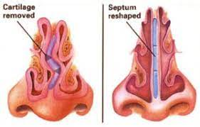
(V) Surgery
Usually not indicated
Not a last resort but complementary
Comorbid or complicating conditions eg: Marked deviated nasal septum(DNS), Turbinate hypertrophy, CRS.

Slide 41
NON-ALLERGIC RHINITIS
The term Non-allergic rhinitis is commonly applied to a diagnosis of any nasal condition in which the symptoms are identical to those seen in Allergic rhinitis, but an allergic aetiology has been excluded.
Occur more frequently in adults than in children,
More likely to be perennial than seasonal.

Slide 42
TYPES:
1.Vasomotor rhinitis
2.Infection
3.Rhinitis associated with physical or chemical factors
4.Drug, food induced rhinitis
5.NARES, aspirin sensitivity
6.Rhinitis of pregnancy
7.Atrophic rhinitis

Slide 43
Vasomotor Rhinitis
Autonomic disturbance – excessive parasympathetic activity
No specific cause found
Symptoms : rhinorrhoea, sneezing, nasal obstruction

Slide 44
Neurovascular disorder
No specific antibodies
Nonspecific reflex hypersensitivity
Caused by various influences:
-Change of temperature or humidity
-Alcohol , dust, smoke, mechanical irritation, stress, anxiety neurosis, endocrine disorders.
Drugs: (e.g., antihypertensive agents as reserpine or beta-blockers, oral contraceptives)

Slide 45
Diagnosis
Typical history
Negative allergen tests
No elevated IgE in the secretion

Slide 46
Conservative Treatment
Elimination of irritant factors
Antihistamines
Nasal decongestant drops
Oral decongestant drugs
Steroids (e.g., beclomethasone)
Metabolic & endocrine systems

Slide 47
Surgical Treatment
-Turbinate surgery --Electrocautery,cryosurgery, laser
-Correction of anatomical deformity
-Conchotomy
-Parasympathetic nasal fibers divisions
(vidian neurectomy)

Slide 48
Atrophic rhinitis
Predominantly in women & is charaterised by progressive atrophy of the nasal mucosa & underlying bone of the turbinates.
Leads to formation of thick crusts, which leave a constant foul smell ( ozaena) in nose.
Nasal cavities are enlarged & there is sensation of nasal congestion.
Thought to be due to infection with klebsiella ozaenae.

Slide 49
Clinical features
Greenish–yellow or brownish-black crusts
Wide nasal cavity
Atrophic mucosa & dry
Subepithelial layer fibrosis
Fetid secretion &crusts (Ozena)
Anosmia & social problem
Nasal obstruction
Mucosal changes

Slide 50
Pathogenesis
-Unknown but is multifactorial
-Common in orientals than in whites than in blacks
-Abnormally wide nasal cavity
-Mucosal atrophy& bony nasal skeleton.
-Respiratory epith.→ keratinized sq. metaplasia
-Destroyed mucociliary cleaning system
-Bacterial proteolysis decomposed the thick & gluey secretions

Slide 51
Secondary Atrophic Rhinitis
Nasal Trauma
Extensive surgery
Occupational exposure to:- Glass, wood, asbestos, etc.

Slide 52
Diagnosis
Gluey, dry, greenish-yellow secretions & crusts
wide nasal cavity & very small turbinates
Foul-smelling crusts

Slide 53
Treatment
Nasal douching
Alkaline nasal lotion
Oily nasal drops, emulsions, or ointments
Steam inhalations
Osmotic Powders :Dextrose

Slide 54
Surgical Treatment
Young’s operation
Both nostrils are closed completely just within nasal cavity by raising flaps. Opened 6 month or later.
Modified Young’s operation
to avoid discomfort of bilateral nasal obstruction, nostrils are partially closed.

Slide 55
Hormonal rhinitis- pregnancy: Oestrogens cause vascular engorgement in the nose, leading to nasal obstruction and/or nasal hypersecretion.
EMOTIONALLY INDUCED RHINITIS
Emotional factors such as stress and sexual arousal have been documented to affect the nose, as a result of autonomic stimulation.
Drug induced: aspirin, other NSAIDs, beta-blockers, ACE inhibitors, methyl dopa, nasal topical decongestants induce symptoms of rhinitis when administred either topically or systemically.

Slide 56
FOOD-INDUCED RHINITIS
Certain foods and alcoholic beverages can induce nonallergic rhinitis,
Underlying mechanisms are largely unknown.
Hot and spicy foods lead to a watery rhinorrhoea termed 'gustatory rhinitis', probably as a result of the capsaicin stimulating the sensory nerves to release neuropeptides and tachykinins.
Alcoholic beverages are thought to induce symptoms as a result of vasodilation.

Slide 57
RHINITIS DUE TO PHYSICAL AND CHEMICAL FACTORS
In individuals with sensitized nasal mucous membranes. Cold, dry air has been shown to lead to a condition known as skier's nose, in which rhinorrhoea features prominently.
Rhinitis medicamentosa
Persistent overuse of the topical nasal vasoconstrictors also leads to nasal decongestion by a mechanism involving a rebound effect following withdrawal of these drugs, excessive use of these agents may also lead to nasal hyper-reactivity and hypertrophy of the nasal mucosa known as rhinitis medicamentosa.

Slide 58
NARES:- condition where there is presence of >20% eosinophils in nasal smears of symptomatic patients with perennial sneezing attacks, profuse watery rhinorrhoea, nasal pruritis, incomplete nasal obstruction & often loss of smell.
Marked feature is lack of evidence of allergy, as indicated by negative SPT &/or absence of serum IgE antibodies to specific allergens.
Triad of nasal polyposis , intrinsic asthma, intolerance to aspirin-sampter’s triad.

Slide 59
Ocupational rhinitis
Episodic work related symptoms of rhinitis which usually manifest on weekdays & abate during weekends & holidays.
Risk factors for developing occupational rhinitis are:
-Exposure{intensity & duration}
-Atopy
-Smoking.
Occupational rhinitis frequently coexists with asthma & conjuctivitis.
Prevention is the best approach .
In medical therapy only non sedating antihistamines should be used.

Slide 60
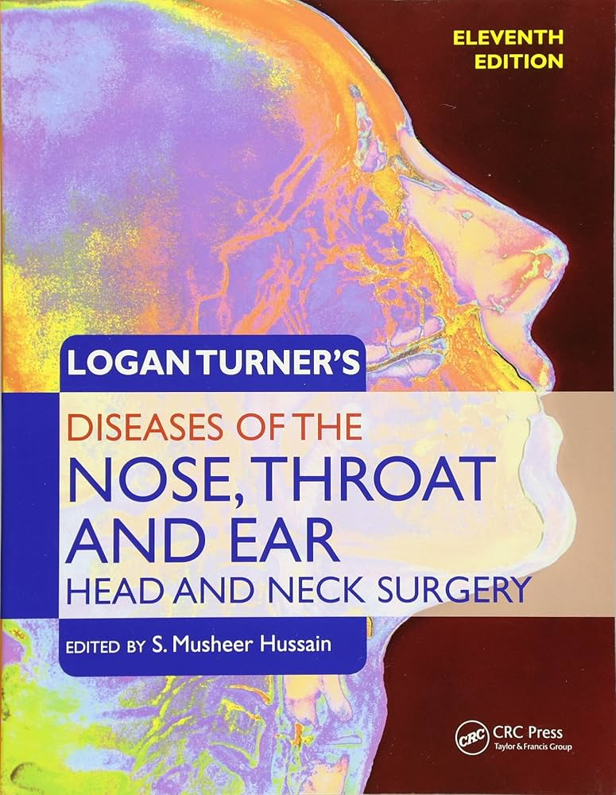
Source
LOGAN TURNER

